Slide 1
k-Nearest-Neighbor Classifiers

Slide 2
k-Nearest-Neighbor Classifiers
The k-nearest-neighbor method was first described in the early 1950s.
Labor intensive when given large training sets, and did not gain popularity until the 1960s.
When increased computing power became available->widely used in the area of pattern recognition.
Nearest-neighbor classifiers are based on learning by analogy.
Compares a given test tuple with training tuples that are similar to it.

Slide 3
The training tuples are described by n attributes.
Each tuple represents a point in an n-dimensional space.
All of the training tuples are stored in an n-dimensional pattern space.
When given an unknown tuple, a k-nearest-neighbor classifier searches the pattern space for the k training tuples that are closest to the unknown tuple.
These k training tuples are the k “nearest neighbors” of the unknown tuple.

Slide 4
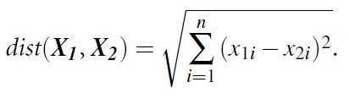
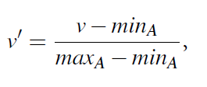
“Closeness” is defined in terms of a distance metric, such as Euclidean distance.
The Euclidean distance between two points or tuples, say, X₁ = (x₁₁, x₁₂, … , x_{1n}) and X₂ = (x₂₁, x₂₂, ... , x_{2n}), is
Normalize the values of each attribute in the range[0,1] - Min-max normalization
where min_{A} and max_{A} are the minimum and maximum values of attribute A.

Slide 5
The unknown tuple is assigned the most common class among its k nearest neighbors
When k=1, the unknown tuple is assigned the class of the training tuple that is closest to its pattern space.
Nearest neighbor classifiers can also be used for prediction, that is, to return a real-valued prediction for a given unknown tuple.
In this case, the classifier returns the average value of the real-valued labels associated with the k nearest neighbors of the unknown tuple.

Slide 6
How are distance computed for attributes?
Categorical attributes
When comparing the values of the attribute in tuple X₁ with that in tuple X₂,
If the two are identical, then the difference between the two is taken as 0.
e.g., tuples X₁ 1 and X₂ both have the color blue
If the two are different , then the difference is considered to be 1
e.g., tuple X₁ is blue but tuple X₂ is red

Slide 7
Handling missing values
In general, if the value of a given attribute A is missing in tuple X1 and/or in tuple X2, we assume the maximum possible difference.
Suppose that each of the attributes have been mapped to the range [0, 1].
For categorical attributes, we take the difference value to be 1 if either one or both of the corresponding values of A are missing.
If A is numeric and missing from both tuples X1 and X2, then the difference is also taken to be 1.
If only one value is missing and the other (which we’ll call v’) is present and normalized, then we can take the difference to be either |1-v’| or |0-v’| (i.e., 1-v’ or v’ ), whichever is greater.

Slide 8
How to determine a good value for k, the number of neighbors?
Determining a good value for k, the number of neighbors
Starting with k = 1, we use a test set to estimate the error rate of the classifier.
Process can be repeated each time by incrementing k to allow for one more neighbor.
The k value that gives the minimum error rate may be selected.
In general, the larger the number of training tuples is, the larger the value of k will be (so that classification and prediction decisions can be based on a larger portion of the stored tuples).
As the number of training tuples approaches infinity and k =1, the error rate can be no worse then twice the Bayes error rate (the latter being the theoretical minimum).
If k also approaches infinity, the error rate approaches the Bayes error rate.

Slide 9
k-Nearest-Neighbor Classifiers
Nearest-neighbor classifiers use distance-based comparisons that intrinsically assign equal weight to each attribute.
They therefore can suffer from poor accuracy when given noisy or irrelevant attributes.
The method, however, has been modified to incorporate attribute weighting and the pruning of noisy data tuples.
The choice of a distance metric can be critical.(Euclidean distance, Manhattan distance)

Slide 10
k-Nearest-Neighbor Classifiers
Nearest-neighbor classifiers can be extremely slow when classifying test tuples.
If D is a training database of |D| tuples and k = 1, then O(|D|) comparisons are required in order to classify a given test tuple.
By presorting and arranging the stored tuples into search trees, the number of comparisons can be reduced to O(log|D|).
Parallel implementation can reduce the running time to a constant, that is O(1), which is independent of |D| .
Other techniques to speed up classification time include
the use of partial distance calculations
editing the stored tuples.

Slide 11
k-Nearest-Neighbor Classifiers
In the partial distance method, we compute the distance based on a subset of the n attributes.
If this distance exceeds a threshold, then further computation for the given stored tuple is halted, and the process moves on to the next stored tuple.
The editing method removes training tuples that prove useless.
This method is also referred to as pruning or condensing because it reduces the total number of tuples stored.

Slide 12
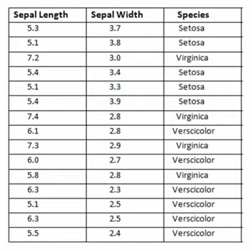

Slide 13
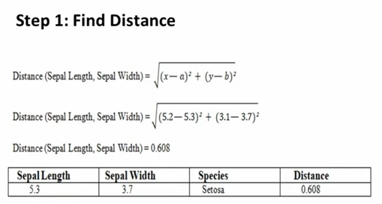

Slide 14
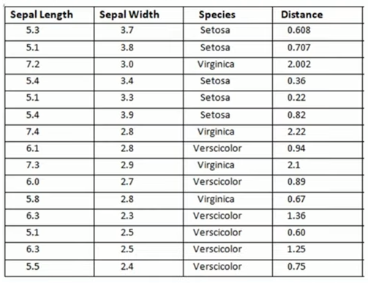

Slide 15
Step 2: Find Rank

Slide 16
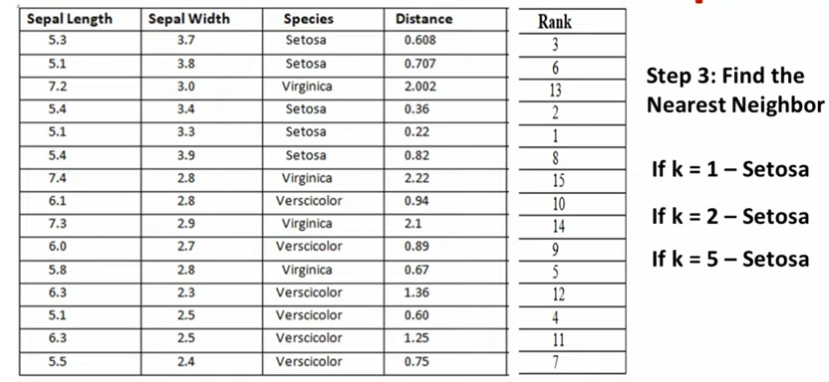
Step 3: find the nearest neighbour

Slide 17
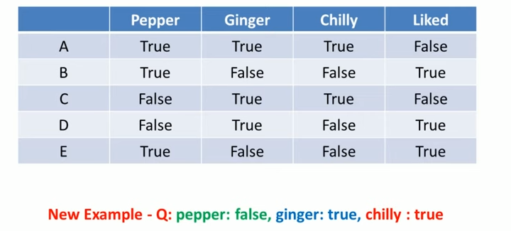

Slide 18
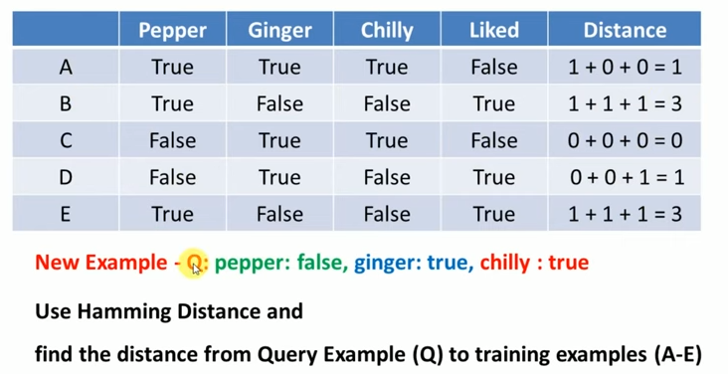

Slide 19
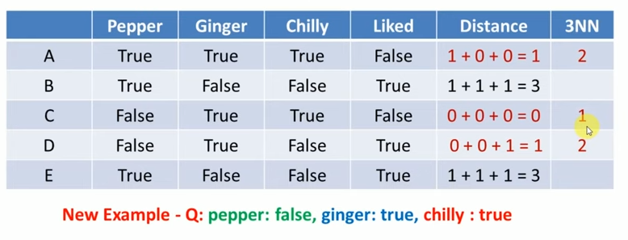
Classified as=> Liked= False

